Slide 1


amazon
CASE STUDY
Analysis on Amazon Sales
Presented by
Sayooj R

Slide 2
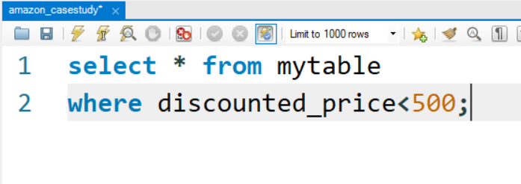
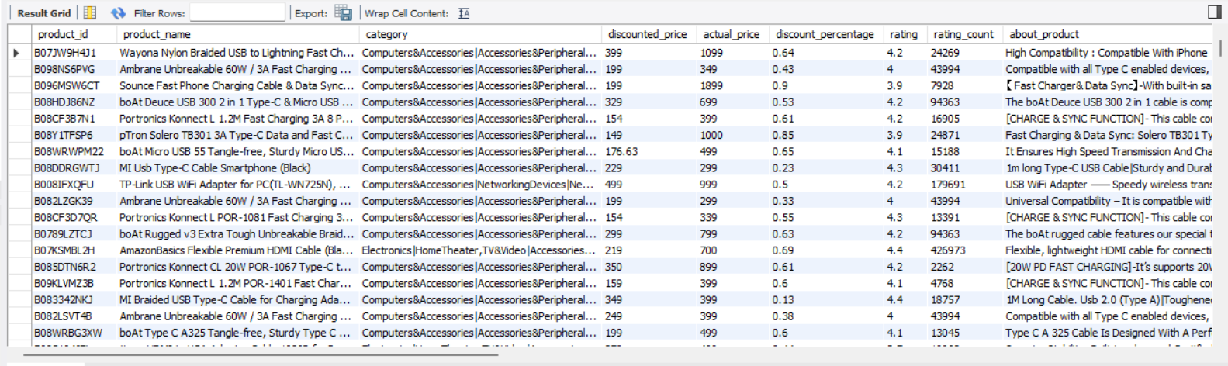
1. List all products with a discounted price below ₹500.

Slide 3
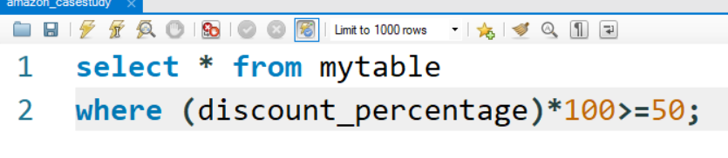
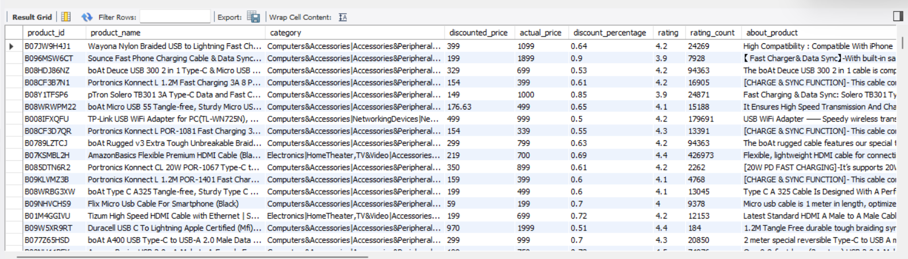
2. Find products with a discount percentage of 50% or more.

Slide 4
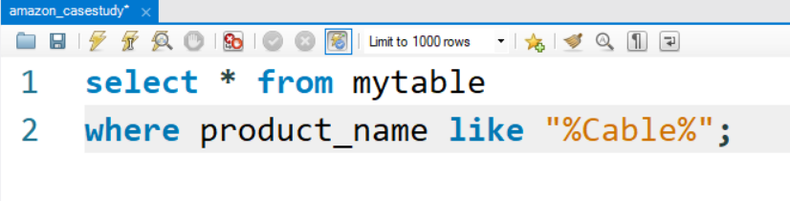
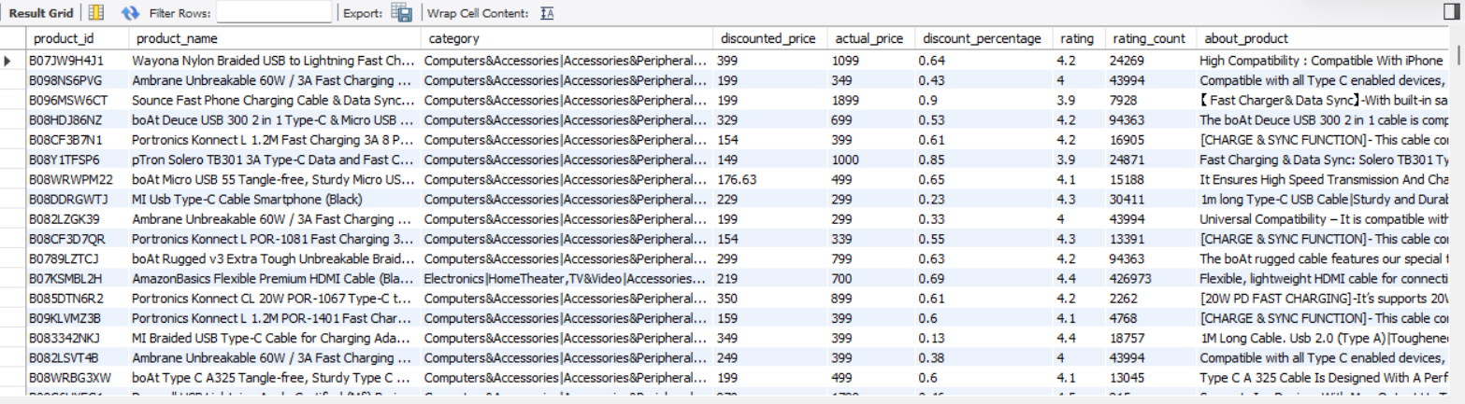
3. Retrieve all products where the name contains the word "Cable."

Slide 5
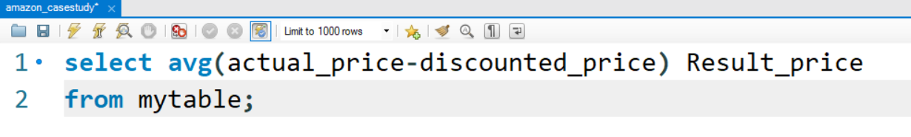
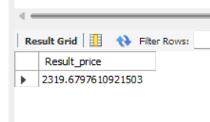
4. Display the difference between the average of the actual price and the discounted price for each product.

Slide 6
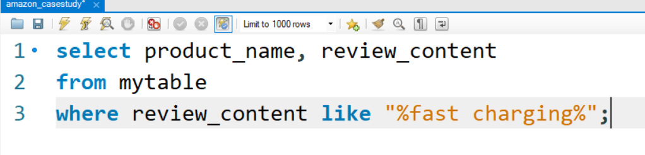
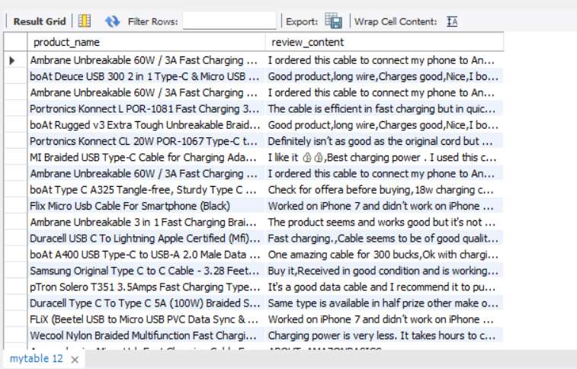
5. Query reviews that mention "fast charging" in their content.

Slide 7
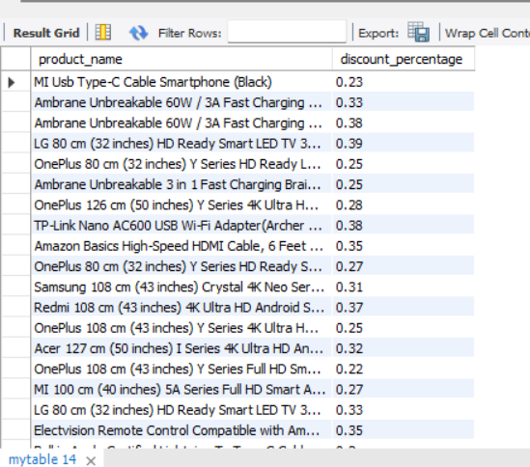
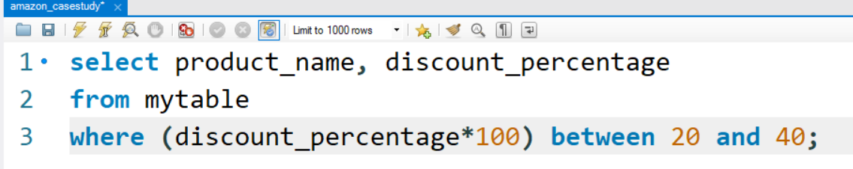
6. Identify products with a discount percentage between 20% and 40%.

Slide 8
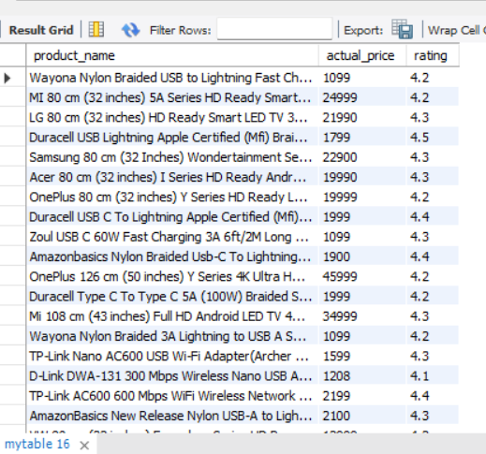
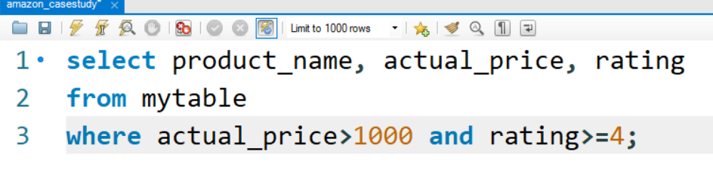
7. Find products that have an actual price above ₹1,000 and are rated 4 stars or above.

Slide 9
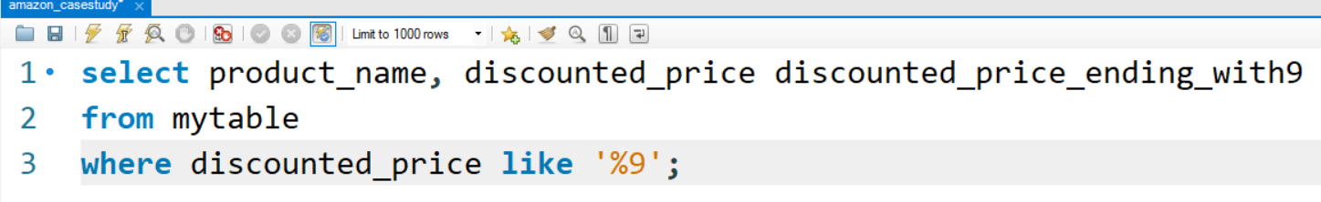
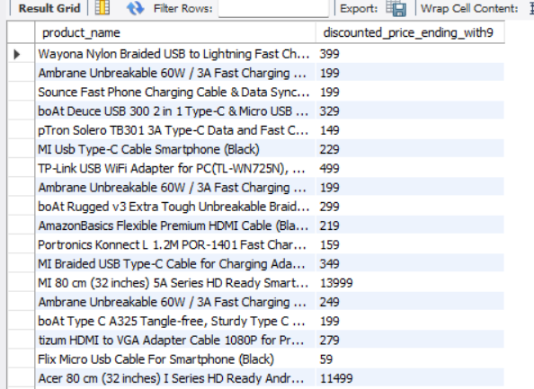
8. Find products where the discounted price ends with a 9

Slide 10
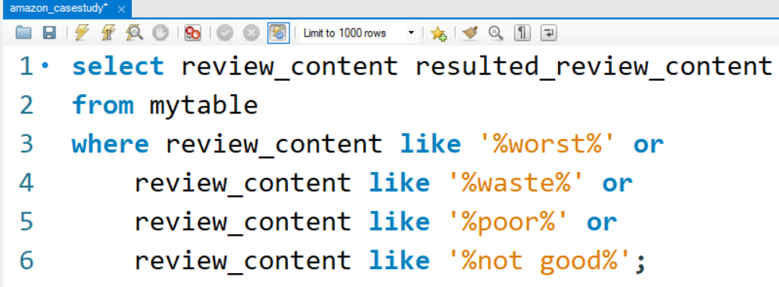
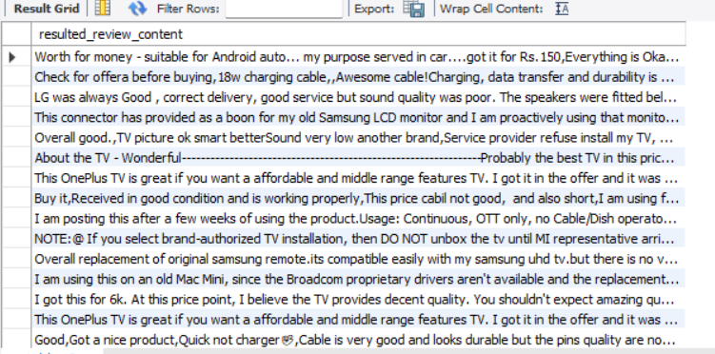
9. Display review contents that contains words like worst, waste, poor, or not good.

Slide 11
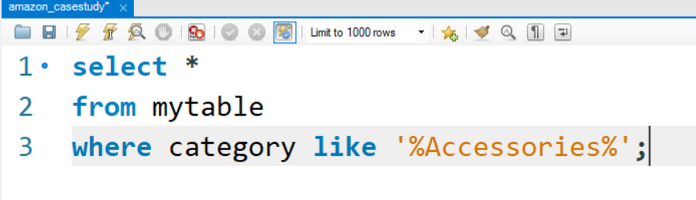
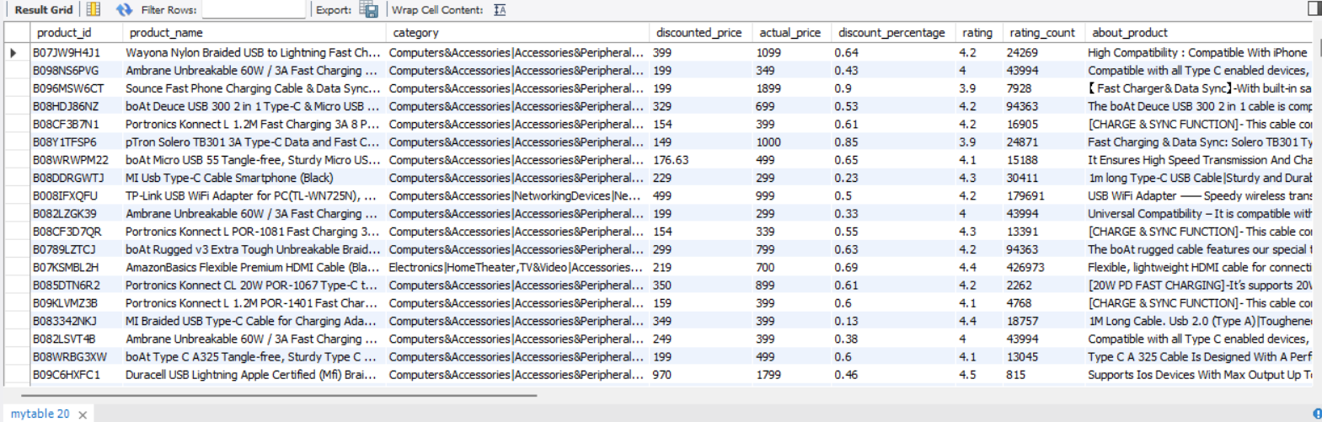
10. List all products where the category includes "Accessories."

Slide 12

Thank you

